Slide 1
COVID-19: Partner Toolkit
For the week of April 19, 2020
Last updated April 19, 2020

Slide 2
Key Messages
With this rollout of the expanded unemployment assistance:
The more people prepare before they apply,
the smoother their process will be to get their benefits
Everyone who is eligible will get their money
– it is not going to run out – and will be paid retroactive to their date of eligibility

Slide 3
Key actions/tools for people to do
Overall, people should start at WWW.ESD.WA.GOV to resolve questions and for step by step instructions on how to apply for unemployment benefits – whether regular or expanded.
Independent contractors, self-employed & those without wages submitted to us:
Make sure you prepare. This page is targeted to you and helps you get ready to have your wage documentation together, do the application checklist and more.
Download these instructions before you start
Participate in Webinars on how to apply for the new expanded assistance program
Apply online and reserve calling our call centers for any specific claims issues that may arise
Phone numbers
Have questions (after you’ve checked the website first): 833-572-8400
Filing your weekly claim over the phone : 800-318-6022
Claims inquiries that can’t be answered online : 800-318-6022
Virtual Chat
Folks can seek answers to questions through our new Virtual Chat: https://www.worksourcewa.com/

Slide 4
Emerging issues and mitigations
High demand has caused performance issues on our phones, in our account sign-up system and through our online application
We have made our website instructions and Q&A much more robust and are trying to route all questions first to our website so we can reserve phones for claimant issues
We have increased our staffing levels for customer service and they will ramp up to 1000 by later this week
We are further increasing our sign-in portal bandwidth and are going to be continually responding to the concerns we see as needed
Especially with the new laws, the application is still complex
We have posted and emailed extensive instructions (see the email section in this deck). People should use them. There are many scenarios laid out that should address the majority of situations. If their questions are still not answered, they should call
Filing a weekly claim is new to many and we will have enormous volumes each Sunday
We will be emailing claimants with instructions and reminders proactively
We will inform people that it can be done anytime Sunday-Saturday and that they still get their money if they file after Sunday
With hundreds of thousands of people filing weekly claims, we are going to be addressing our throughput for both the online weekly claims as well as those through the automated phone system

Slide 5
Top Q&A

Slide 6
Top questions/issues we receive
Question / Issue | Answer / Response
I can’t get through on the phone lines and need help! | Please point people to the website first to answer their questions. If they are asking about a specific claim, they’ll still need to contact customer service
I can’t get through and am worried I’ll miss out on some of my benefits! | Please assure people that they will get paid retroactively to the date of their eligibility. They should go to the website to see if their questions can be answered with the information there first. With questions only, they can also call our 1-800 number or use virtual chat found on www.worksourcewa.com.
Will the money from the Federal CARES Act run out? | No. The benefits will be there for those who are eligible and need them
I can’t sign-up for a SAW account | Please watch this video. If there are still problems, they will need to call our customer service center.
I’m an independent contractor, what do I need to do? What documentation will I need to submit? | Go to the ESD.WA.GOV website where there are instructions on what to do and what you need to be prepared to apply. The very best options are tax documents like a 2019 tax return, 1099s, W2s

Slide 7
Top issues/questions we receive cont.
Question / Issue | Answer / Response
I applied and haven’t heard back. What’s going on? | There is very high demand – with 1000% increase in call volumes since the crisis began. They are working hard to meet that demand so please check the status on the website and, if you haven’t heard back in a couple of days, try calling.
I’m a gig-worker – what do I do? | Apply online at WWW.ESD.WA.GOV
I’m already on UI – am I eligible for the new benefits? Do I need to do anything to access them. | Yes – the Federal CARES act includes an additional $600/week through the end of July and 13 additional weeks of benefits. Anyone on unemployment benefits will be eligible for those additional benefits. You do not need to do anything for the $600 but will need to add the 13 weeks to your existing benefits by clicking a link in your account.
How long will it take to get my money? | Once approved and an initial claim is filed, it is taking 7-10 days – especially since we waived the waiting week. It can also be as fast as 24-48 hours for those with direct deposit.
I was approved and got my first amount of money, but haven’t since? What’s up with that? | Once approved, Unemployment Benefits recipients need to file weekly claims. They can do so from Sunday through Saturday either online or over the phone.

Slide 8
Independent contractors/self-employed
The federal CARES Act expands unemployment benefits to those otherwise not eligible and who have been impacted by COVID-19
This may include some independent contractors and self-employed workers
When they apply, they will need to submit wage documentation for the past year
We have posted very specific instructions on ESD.WA.GOV for what they should do
To get them their benefits as quickly as possible AND, at the same time, protect taxpayers from fraud, we are paying them right away the minimum weekly benefit amount designated from the federal CARES Act for this expanded unemployment assistance ($235 for full-time workers) plus the extra weekly $600 also designated from the federal CARES Act. In other words – they will receive $835 per week until we verify their wage documentation. When verified, we will pay them the full weekly benefit amount for which they’re eligible – including any retroactive payments to the date of their eligibility.
They can speed up that wage verification process by having their documentation ready before applying. We will have suggestions on document types in our instructions, but to give you an idea, the best forms include:
2019 tax return
1099 forms
Other formal tax documentation

Slide 9
Email/Newsletter content for your use

Slide 10
Proactive emails & instructions we sent
This past Sunday, we emailed approximately 750K people in the following categories with information about the update and what they need to do/not do to avail themselves of the new benefits. This also includes clear instructions, how to avoid common mistakes that delay benefits, and more.
Those already on UI who have not yet reached 26 weeks of benefits
Those who were on UI, but who exhausted their 26 weeks of benefits
Those who were deemed ineligible/denied unemployment benefits – including independent contractors, self-employed workers and those without enough hours
Here is a link to the content of those emails for you to use
Pro-Tip: This is an especially helpful tool for caseswork!

Slide 11
Email/newsletter language
Dear XXXXXX:
Thank you for playing your continued part in flattening the curve by Staying Home and Staying Healthy! For those awaiting economic relief, I have an important update and some recommended instructions.
This past weekend, the Employment Security Department updated its systems to enable the new Federal CARES Act. This expands unemployment benefits to those not previously eligible for unemployment insurance, for example, independent contractors, those who are self-employed and those with fewer than 680 hours worked in the past year; adds $600 on top of weekly benefit amount for anyone on unemployment assistance; and adds 13 more weeks to someone’s unemployment benefits
However, we have heard from the Employment Security Department that, despite tremendous efforts to increase their capacity for high demand, some people are having challenges getting through online or on the phone. While the system is working and record numbers of applications have been successfully received for the expanded assistance and, we encourage people to try at off-hours or later in the week. Once approved, people will be paid retroactive to their date of eligibility and funds are taking an average of 7-10 days and as little as 24-48 hours with direct deposit.
Rest assured, the funds for unemployment benefits will not run out. We have heard that some people are concerned that, if they don’t apply right away, they will miss out on their benefits. That is not the case. Whenever people apply, they will be paid the full amount for which they are eligible and they will be paid retroactive to the date of their eligibility.
Here are key tools and actions we recommend you use. The more prepared you are, the smoother the process.
Overall, people should start at WWW.ESD.WA.GOV to resolve questions and for step by step instructions on how to apply for unemployment benefits – whether regular or expanded.
Independent Contractors, Self-employed & those with fewer than 680 hours:
Make sure you prepare. This page is targeted to you and helps you get ready to have your wage documentation together, do the application checklist and more.
Download these instructions before you start
Participate in Webinars on how to apply for the new expanded assistance program
Apply online and reserve calling the call centers for any specific claims issues that may arise
Note: You do not need to do anything to receive the additional $600 per week enhancement.
To reach ESD by phone:
Have questions (after you’ve checked the website first): 833-572-8400
Filing your weekly claim over the phone : 800-318-6022
Claims inquiries that can’t be answered online : 800-318-6022
Virtual Chat
Folks can seek answers to questions through ESD’s new Virtual Chat: https://www.worksourcewa.com/
Thank you for your understanding and patience while they address this exceptional demand.
Sincerely,
XXXXXXXX

Slide 12
Email template: can’t get through
Dear XXXXXX:
Thank you so much for contacting us regarding unemployment insurance benefits. I am so sorry that you are having difficulty getting assistance.
As you know, this is a historic time. The Employment Security Department has received an unprecedented flood of applications for assistance. They are doing the best they can to meet this need by hiring additional staff, expanding service hours and upgrading their technology.
Many of the calls they are receiving and that we have received from constituents are now answered on their website (ESD.WA.GOV) where they have been providing up to date information and resources directly addressing the current circumstances of Washingtonians. They also will be providing information and instructions on accessing unemployment assistance through their new Action Alert newsletter found here.
Although it may be frustrating, if you have an issue that must be resolved by speaking to an agent, please continue to call. There are thousands of individuals getting through on the phones every day.
It is important to know that, the unemployment benefits programs will not run out of money and, regardless of when you get through, you will receive retroactive payments back to your eligibility date.
Thank you for your understanding and patience through this difficult time.
Sincerely,
XXXXXXXXX

Slide 13
Email template: specific claim needs
Dear XXXXXX,
Thank you for your email and bringing this to our attention.
During these unprecedented times, the Employment Security Department is inundated with applications, claims, and inquiries. They are putting all their hearts, souls and hard work in to meet the needs of those we all serve.
Unfortunately, because of this exceptional demand, our office is not able to escalate specific claims at this time. To inquire about your claim, you will need to keep trying to reach their Claims Center agents by calling 800-318-6022 during the assigned day(s) based on your question(s) or by utilizing eServices. ESD has expanded hours and is hiring more people to be able to serve you faster.
In the meantime, please visit their website for the most up-to-date information and subscribe to email updates about COVID-19 guidance so you receive their alerts as new guidance becomes available.
We ask for your patience and partnership as we adapt to these unprecedented times. We will get through this together.
Sincerely,
XXXXXXXXX

Slide 14
Social media and graphics

Slide 15
Social media suggestions for the week of 4/12
Subject | Proposed language and link | Images to consider from the next 2 slides
Launch of expanded benefits | New unemployment benefits from the CARES Act have rolled out – expanding eligibility, increasing the $$s and extending the time! The more prepared you are, the smoother your application process will go. Learn more at www.esd.wa.gov | Cares ACT Relief for workers…
Rest assured | Seeking unemployment benefits? Everyone who is eligible will get their money – it is not going to run out – and you will be paid retroactive to your date of eligibility. More info here: www.esd.wa.gov | Benefits are retroactive
First step | Make sure when you apply for Unemployment benefits that the first step is not a stumble! Sign up for your account NOW to be ready – watch the video 1st and then sign-up! https://youtu.be/JgrLhqbtHQ4 | Get Ready to Apply
All those not currently eligible | Expanded unemployment benefits applications are available for Independent Contractors, Self-Employed Workers, those with fewer than 680 hours and more who were impacted by COVID-19. Sign up for a webinar before applying so you’re maximally ready! https://esd.wa.gov/newsroom/introduction-to-unemployment-insurance-public-webinar | New Webinar Series Self-employed & independent contractors

Slide 16
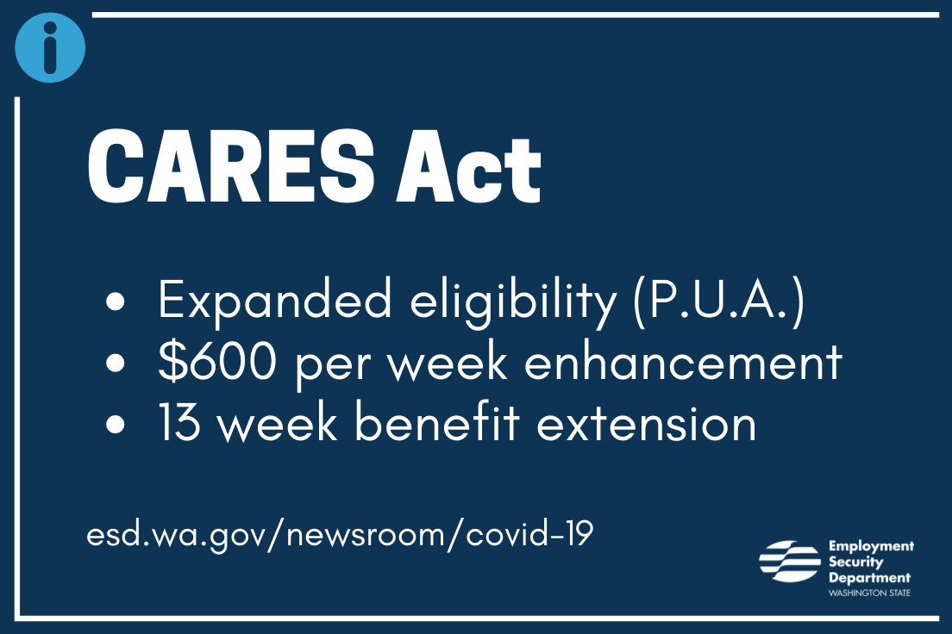
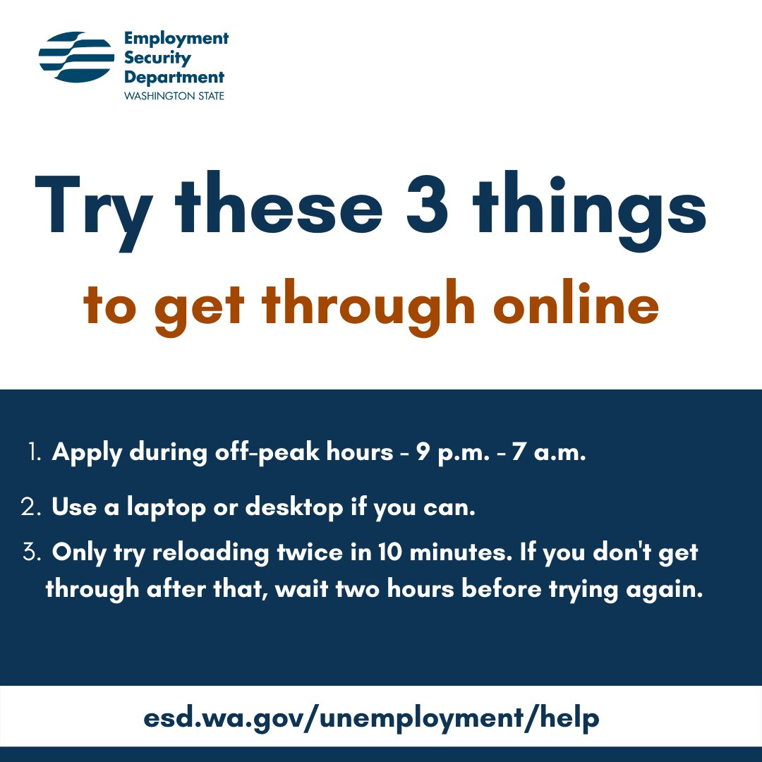
Images to promote in social channels
Please follow and share our posts:
Twitter @esdwaworks, FB @WashingtonESD, Instagram @washingtonesd
If you want to share yourself – here are images to copy and past or drag and drop into your social media or your email templates

Slide 17
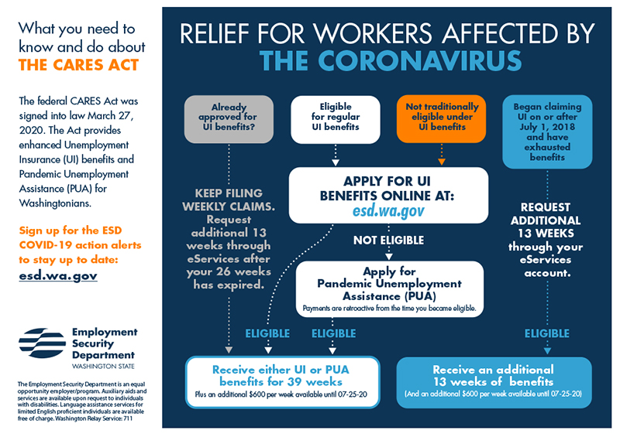
Other Useful Graphics

Slide 18
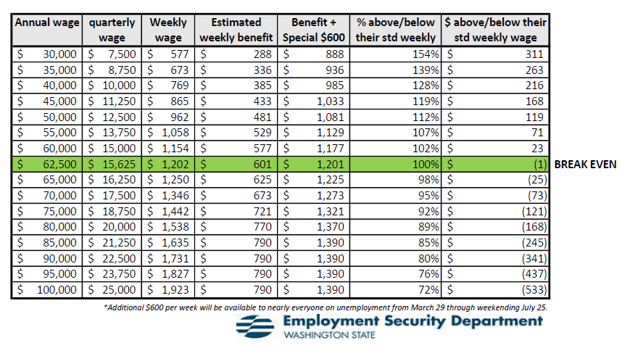
Weekly Benefit Amounts w/the Federal CARES act + $600
People can estimate their weekly benefit amount here: benefit calculator on esd.wa.gov
Note – this provides an estimate. For the actual weekly benefit amount, an individual has to apply

